Slide 1
Trading Team 2 Project
SEM 2 - 2022
16/03/2022

Slide 2
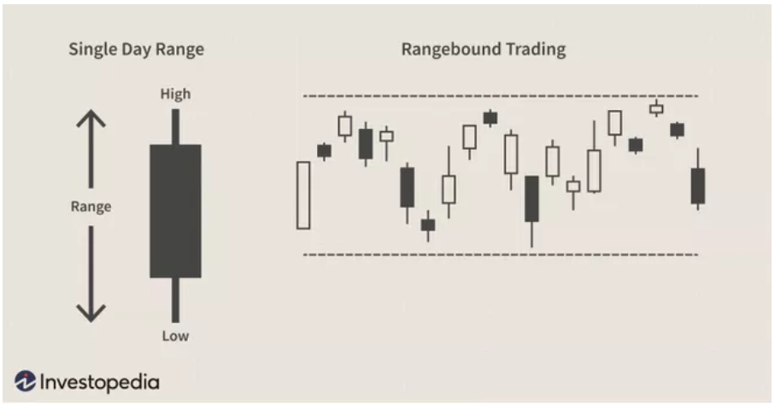
What is Range Trading?
‘A trading range occurs when a security trades between consistent high and low prices for a period of time.’
- Investopedia

Slide 3
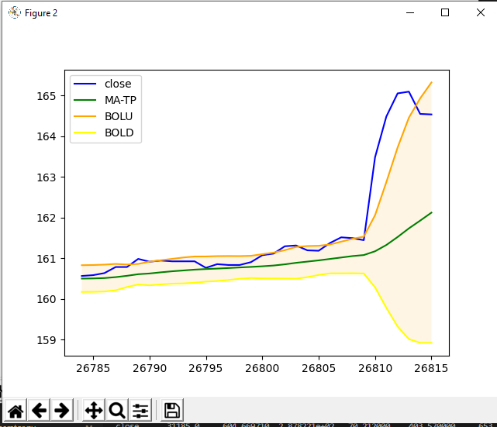
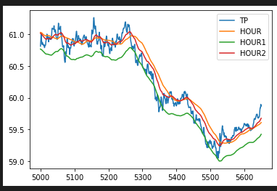
Range Trading- Indicators
We tried to plot out different Indicators in different periods using matplotlib just to visualise and get familiar to the indicators and experiment with them.
Bollinger band
Average True Range

Slide 4
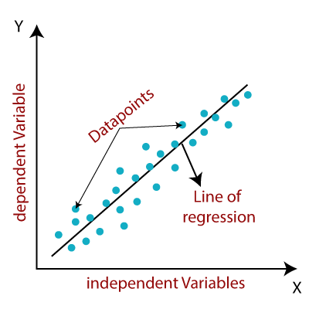
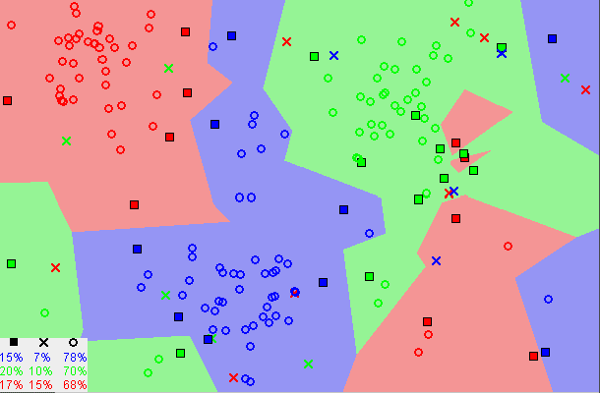
Machine learning
After trying out the indicators, we realised they are not enough to build a reliable algorithm so we decided to co-op machine learning in the algorithm. We decide to explore linear regression and KNN.
Linear Regression
Linear Regression is the supervised Machine Learning model in which the model finds the best fit linear line between the independent and dependent variable.
KNN
The number of nearest neighbors to a new unknown variable that has to be predicted or classified is denoted by the symbol 'K’. It assumes that similar things exist in close proximity.

Slide 5
Data Processing(Feature engineering)
The aim of feature engineering is to prepare an input data set that best fits the machine learning algorithm as well as to enhance the performance of machine learning models.

Slide 6
Trading strategy

Slide 7
Backtesting

Slide 8
Challenge
Learning machine learning within a very limited time and applying it as our algorithm
Keeping on track with the group
Very limited financial background/knowledge

Slide 9
Conclusion
What went well?
We are trying new method and willing to learn new things
What didn’t go so well?
Lack of communication and commitment
What can be improved?
Better schedule + deadline
Start early

